Slide 1

HARNESSING AI FOR PRECISE ESTIMATION OF MEDICINAL LEAF CHARACTERISTICS
MANGALORE INSTITUTE OF TECHNOLOGY & ENGINEERING
(A Unit of Rajalaxmi Education Trust ®, Mangalore)
Autonomous Institute Affiliated to V.T.U., Belagavi , Approved by AICTE, New Delhi
Accredited by NAAC with A+ Grade & ISO 9001:2015 Certified Institution
Department of Artificial Intelligence & Machine Learning
18AIP77- Project viva-voice
Team Members 1.NEHA BS (4MT20AI021) 2.PRAVIKSHA (4MT20AI029) 3.SANJAY S M (4MT20AI038) 4.SOORAJ S BHAT (4MT20AI050) | Guided by: Mrs . Radha E G

Slide 2
OVERVIEW
Abstract
Problem Statement
Introduction
Background Of The Project
Literature Review
Novelty of proposed work
System Design of the Proposed Work
Implementation
Conclusion And future work

Slide 3
ABSTRACT
Accurate assessment of medicinal plant leaf characteristics is essential for ensuring their quality and efficacy in healthcare applications. The project endeavours to revolutionize the field of herbal medicine by integrating cutting-edge Artificial Intelligence (AI) techniques with traditional medicinal plant classification methods. With the increasing demand for alternative and natural remedies, accurate identification and classification of medicinal plant species have become crucial for healthcare professionals, researchers, and enthusiasts alike. However, manual classification processes are time-consuming, labour-intensive, and prone to errors. Toaddress these challenges, our project proposes a novel approach that combines the power of deep learning and classic machine learning algorithms. Users receive instant predictions along with supplementary information about the predicted plant species, including medicinal properties, geographical distribution, disease curability, age restrictions, medicinal values, side effects, and precautionary notes. By harnessing AI technologies, our project aims to democratize access to accurate medicinal plant classification and information. This system not only accelerates the identification process but also enhances the reliability and precision of classification results. Moreover, it empowers healthcare professionals, researchers, and individuals with the knowledge needed to make informed decisions about the usage of medicinal plants for various health conditions.

Slide 4
Problem Statement:
Accurate identification and classification of medicinal plant species are crucial for ensuring the quality and efficacy of herbal medicines. Traditional manual classification methods are time-consuming, labor-intensive, and prone to errors, hindering the reliable use of medicinal plants in healthcare. There is a need for an efficient, precise, and accessible system that can instantly classify medicinal plants and provide detailed information about their medicinal properties to support healthcare professionals, researchers, and enthusiasts.

Slide 5
INTRODUCTION
Ayurveda, originating from ancient India, stands as one of the world's oldest holistic healing systems. With roots dating back over 5,000 years, Ayurveda is founded on the profound belief that health and wellness are achieved through balance and harmony within the body, mind, and spirit. It encompasses a comprehensive understanding of human physiology, disease etiology, and therapeutic interventions, making it a timeless repository of knowledge for maintaining optimal health.m their users.
One of the fundamental principles of Ayurveda is the identification and classification of medicinal plants, each possessing unique therapeutic properties that contribute to overall health. However, the manual methods traditionally used for plant species identification are time-consuming and prone to errors, limiting the scalability and effectiveness of Ayurvedic treatments.

Slide 6
In response to these challenges, we endeavor to harness the power of artificial intelligence (AI) to advance the field of Ayurvedic healthcare. By integrating AI technologies with the ancient wisdom of Ayurveda, we aim to revolutionize plant species identification and classification, thereby enhancing the precision and efficacy of Ayurvedic treatments.
Our project, "HARNESSING AI FOR PRECISE ESTIMATION OF MEDICAL LEAF CHARACTERISTICS," represents a transformative endeavor to bridge the gap between traditional Ayurvedic practices and modern technological advancements. Through the development of AI-driven solutions for plant species recognition, we aspire to empower Ayurvedic practitioners with sophisticated tools and methodologies that augment their diagnostic capabilities and therapeutic interventions.
By leveraging AI algorithms trained on multispectral and texture features of medicinal leaves, we seek to automate and streamline the process of plant identification, enabling faster, more accurate, and data-driven decision-making in Ayurvedic practice. Our efforts are aligned with the ancient principles of Ayurveda, which emphasize the importance of personalized and holistic approaches to healthcare, tailored to individual needs and constitution.

Slide 7
BACKGROUND OF THE PROJECT
Deep Learning, CNN, VGG16
Deep Learning is a subset of machine learning focused on training neural networks with multiple layers. CNNs are a type of deep learning model specialized in image processing tasks, utilizing convolutional layers to extract features. VGG16 is a popular CNN architecture known for its deep layers and strong feature extraction capabilities.
Exceptional Feature Extraction: VGG16's CNN architecture offers outstanding feature extraction capabilities, vital for accurately identifying intricate patterns in medicinal plant leaves.
Hierarchical Feature Learning: With its deep architecture, VGG16 autonomously learns hierarchical features from input images, enhancing classification accuracy.
Extensive Training and Pre-Trained Weights: VGG16 has undergone extensive training on large-scale image datasets, and its pre-trained weights provide valuable initialization for our model, expediting training and potentially improving classification performance.

Slide 8
Machine learning, Random Forest
Machine learning, a subset of artificial intelligence, involves training algorithms to learn patterns and make predictions from data without explicit programming. Random forest, a machine learning technique, constructs multiple decision trees during training and combines their outputs to enhance classification accuracy, making it particularly effective for complex and diverse datasets.
Machine Learning Selection: The project adopts machine learning techniques for effective classification of medicinal plant leaves.
Random Forest Algorithm: Specifically chosen for its exceptional classification performance, random forest is employed to accurately predict plant species based on leaf characteristics.
Robust Classification: Random forest excels in handling diverse and complex datasets, ensuring accurate and reliable classification results.

Slide 9
Transfer Learning:
It is a machine learning technique where knowledge gained from solving one task is
applied to a different but related task.
Explained that instead of training a model from scratch on a new dataset, transfer learning
allows you to use pre-trained models that have been trained on large, general datasets.

Slide 10
LITERATURE REVIEW
Sl.no | Paper Title (Year of publication) | Methodology | Identified scope for improvement
1 | The Classification of Medicinal Plant Leaves Based on Multispectral and Texture Feature Using Machine Learning Approach [1] | Image Processing, Edge Detection, Region Marking, Feature Extraction, Feature Fusion, Evaluation | Study limited to six plant leaves; millions exist. Pixel based approach mentioned; future considerations for object-based approach and enhanced data
2 | Automatic Recognition of Medicinal Plants using Machine Learning Techniques [2] | Database Creation, Image Capture, Petiole Removal, Image Specifications, Feature Extraction, Classification. | Dataset Challenges: Acknowledge challenges in collecting, classifying, and sharing large datasets. Opportunities: Advocate for crowdsourcing and deep learning to enhance research efficiency. Practical Application: Propose a web/mobile system for automatic medicinal plant recognition, benefiting local knowledge, taxonomy, and species protection.
3 | A convolutional neural network-driven computer vision system toward identification of species and maturity stage of medicinal leaves: case studies | Leaf Collection, Hyperparameter Optimization, Simultaneous Classification, Evaluation Metrics, Visualization. | Future Scope: Mobile App Development: Extend to mobile app for real-time use. Portable computer vision for fieldwork.

Slide 11
 | with Neem, Tulsi and Kalmegh leaves [3] |  | Data Access: Datasets not public, available on request. Reproducibility Concerns: Limits result reproducibility and follow-up research.
4 | Deep convolutional neural network-based plant species recognition through features of leaf [4] | Methodology Overview, Dataset and Testing, Training Process, Validation Set, Paper Section. | Feature Restriction: Identifies plant species solely based on leaf images, excluding flowers, fruits, or stems. Similarity Challenges: Struggles with plants sharing leaf structures or altered by environmental changes.
 |  |  | Advanced Techniques:
 |  |  | Enhance the system with more advanced deep learning techniques. Dataset Expansion:
 |  |  | Expand dataset to include diverse plant species and variations. Mobile Integration:
 |  |  | Integrate with mobile
 |  |  | applications for increased
 |  |  | accessibility to botanists and
 |  |  | researchers.

Slide 12
NOVELTY OF PROPOSED WORK
Integration of Advanced AI Techniques: The project integrates advanced machine learning algorithms, including the deep learning model VGG16 and the Random Forest algorithm, to achieve precise identification and characterization of medical leaves. This amalgamation of state-of-the-art AI techniques enables more accurate and efficient analysis compared to traditional methods.
Expansion of Species and Enhanced Accuracy: The project significantly advances upon the base paper by expanding the scope from merely four species to encompassing a diverse range of 30 species. This expansion not only broadens the applicability of the model but also enhances its effectiveness in real-world scenarios. Moreover, while the base paper relied solely on machine learning techniques, our project integrates both deep learning and traditional machine learning algorithms, resulting in a notable accuracy improvement from 90% to an impressive 92%. This demonstrates the project's capacity to achieve higher precision and reliability in medical leaf identification, catering to the needs of researchers, healthcare professionals, and environmentalists alike.

Slide 13
Interdisciplinary Approach: By combining expertise from artificial intelligence, computer vision, medical botany, and healthcare, this project operates at the intersection of multiple disciplines. It leverages insights from diverse fields to develop a holistic solution that addresses challenges in plant identification, medical research, and environmental conservation.
User-Friendly Interface and Educational Outreach: Emphasizing accessibility and user engagement, the project aims to develop an intuitive interface that caters to researchers, botanists, and enthusiasts alike. Additionally, educational outreach initiatives seek to bridge the gap between scientific research and public awareness, promoting informed decision-making and sustainable practices.
Enhanced Information Display: After leaf detection, the system displays additional information such as geographic location, medicinal values, diseases curable, age limits, and precautionary notes. This comprehensive approach ensures users have access to vital details for informed decision-making and usage of medicinal plants.

Slide 14
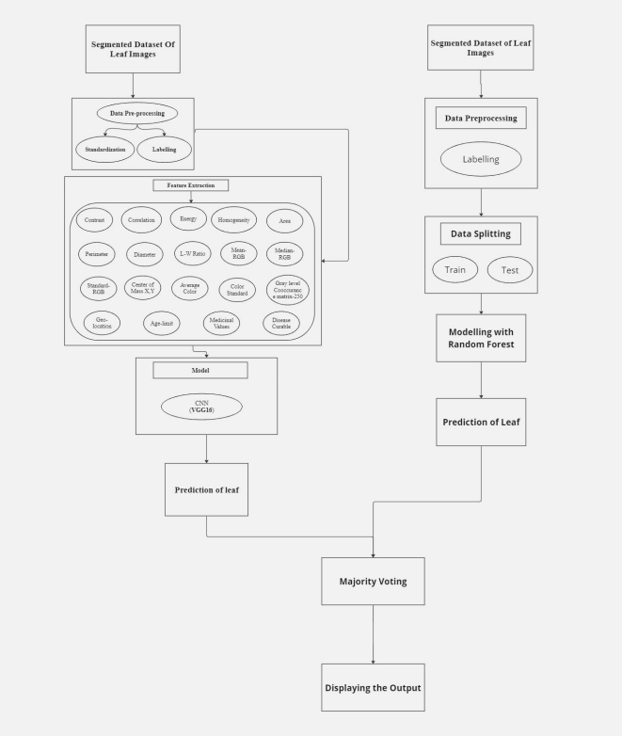
Architectural Diagram

Slide 15
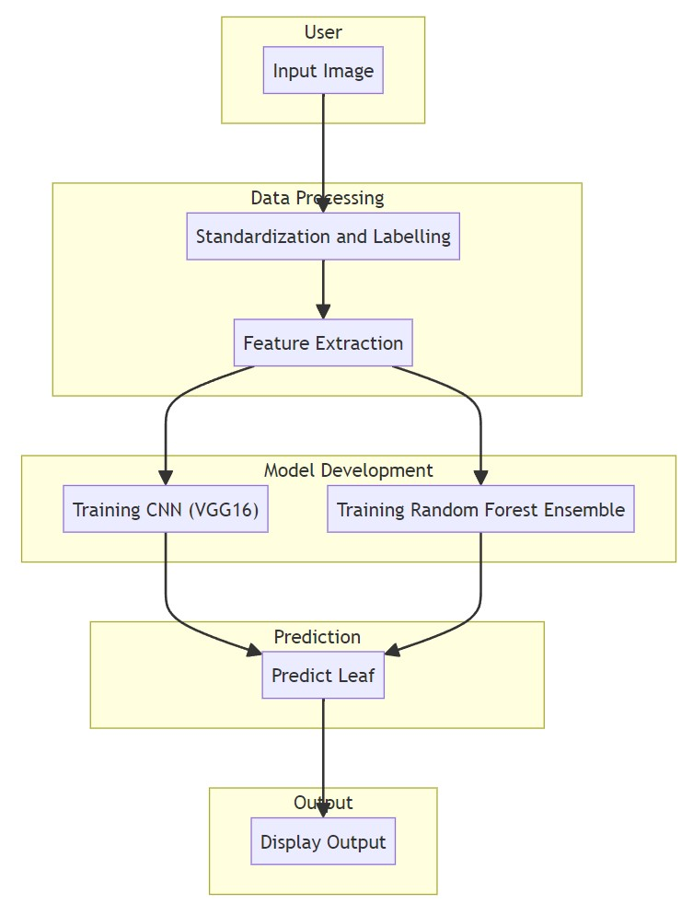
WORKFLOW

Slide 16
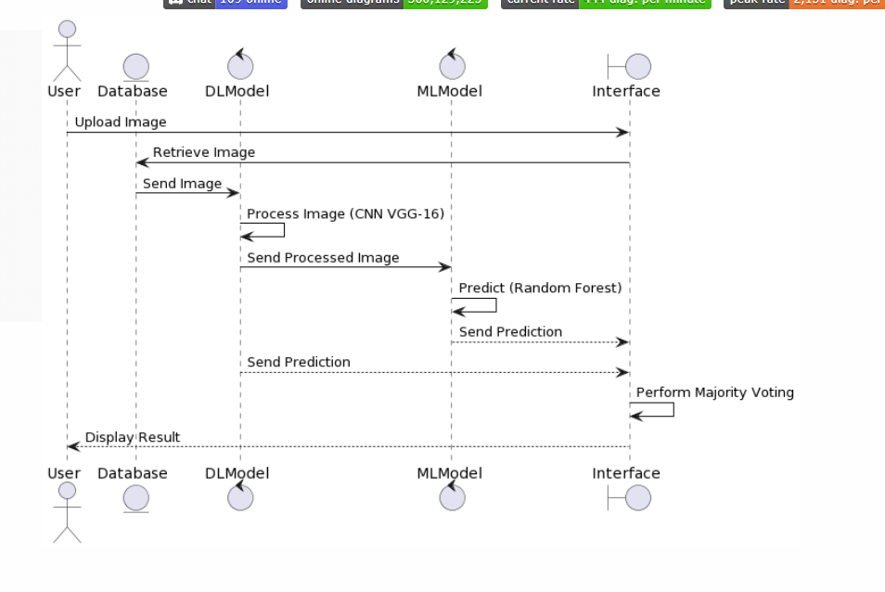
SEQUENCE DIAGRAM

Slide 17
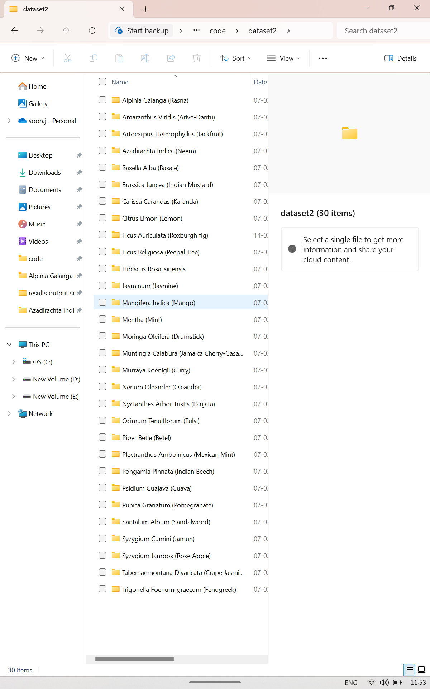
IMPLEMENTATION
DATA COLLECTION
Gather a diverse dataset of medical leaf images, encompassing various species, shapes, sizes, and conditions. This dataset should be annotated with relevant labels and metadata, including leaf attributes, geolocation data, and disease status.

Slide 18
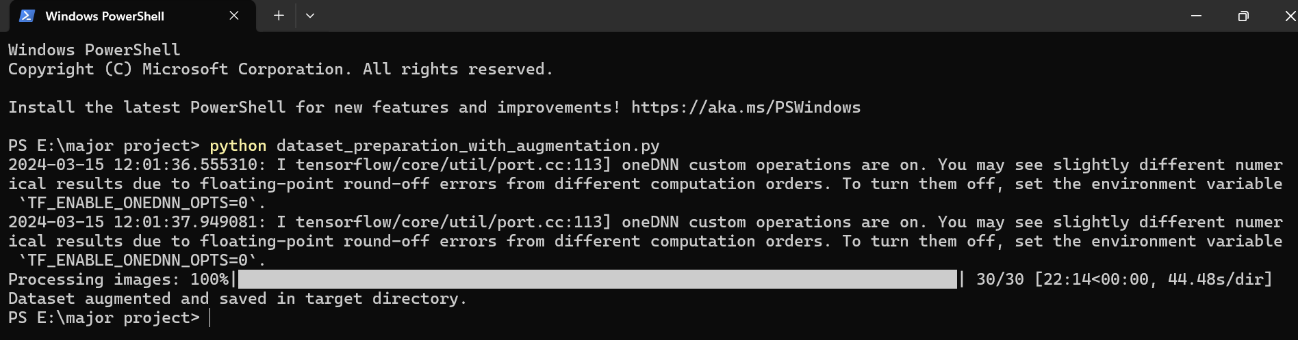
2. PREPROCESSING
Preprocess the collected data to ensure consistency and suitability for training machine learning models. This may involve tasks such as resizing, normalization, augmentation, and feature extraction to enhance the quality and diversity of the dataset.

Slide 19
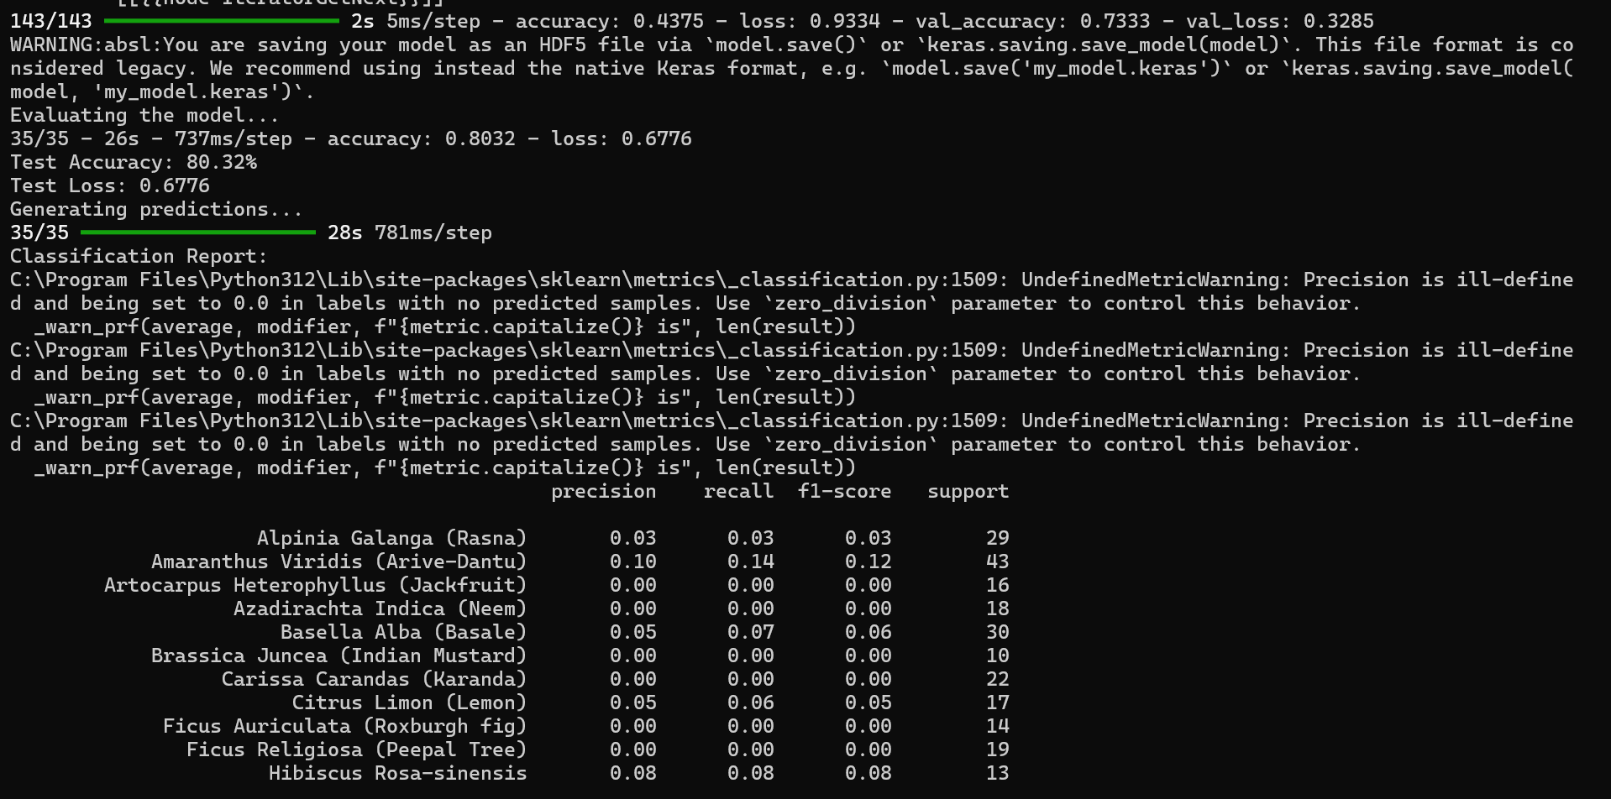
3.Model Development:
Develop machine learning models, leveraging advanced algorithms such as VGG16 and Random Forest, to accurately identify and characterize medical leaves based on the preprocessed data. Train the models using appropriate training techniques, optimization algorithms, and validation procedures to achieve optimal performance.
Training of VGG16 model and acquired the accuracy of 81%
Training of Random Forest model and acquired the accuracy of 92%

Slide 20
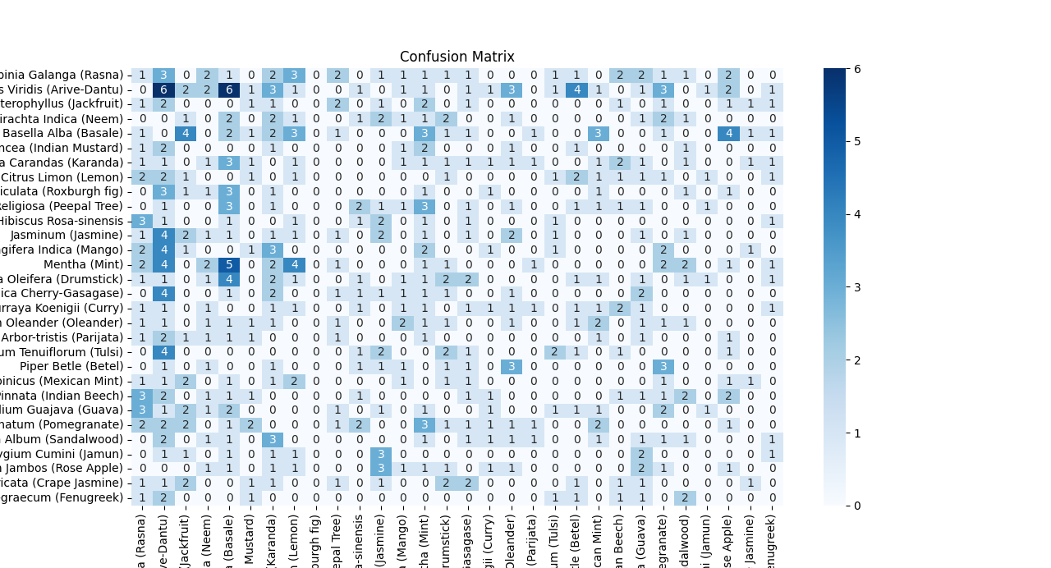
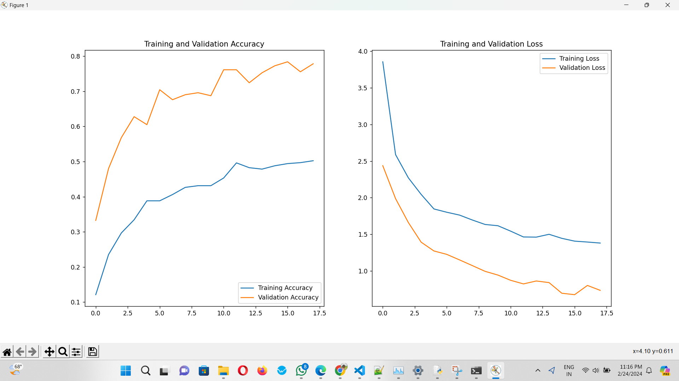
4.Testing and Validation:
Conduct thorough testing and validation of the implemented system to evaluate its performance, accuracy, and robustness across different scenarios and datasets. Use appropriate evaluation metrics and validation techniques to assess the effectiveness and reliability of the system.
VGG-16
Training and validation accuracy and loss
Confusion matrix

Slide 21
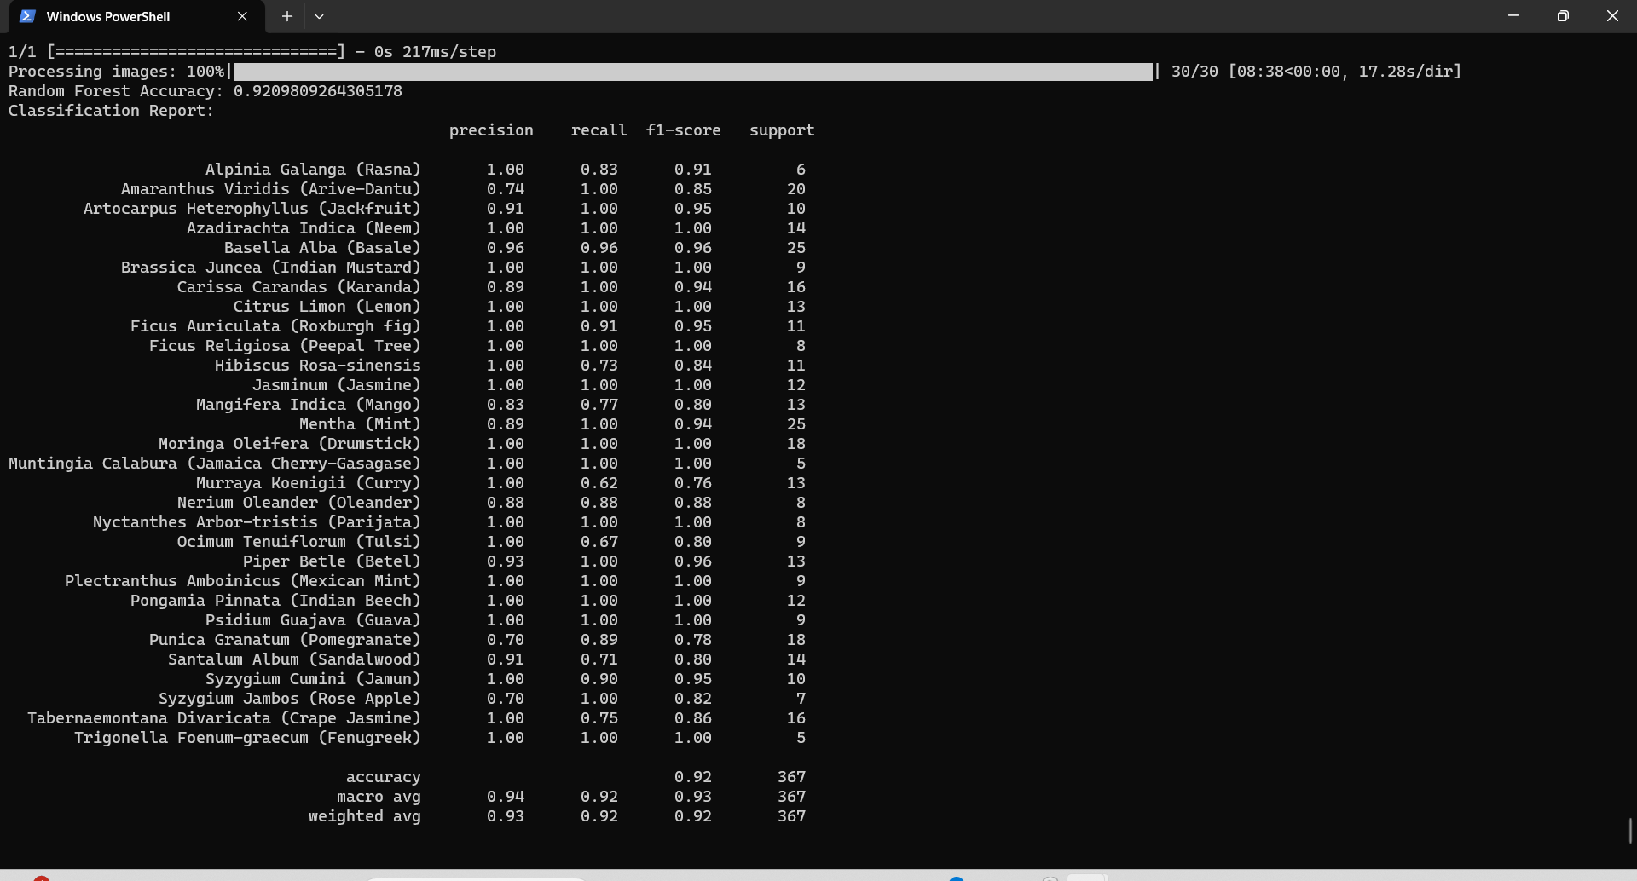
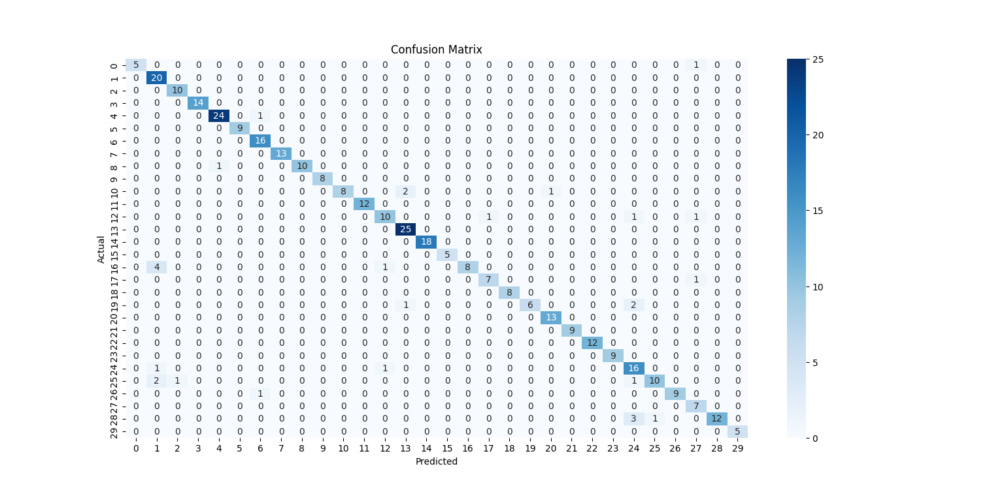
Random forest
Classification report
Confusion matrix

Slide 22
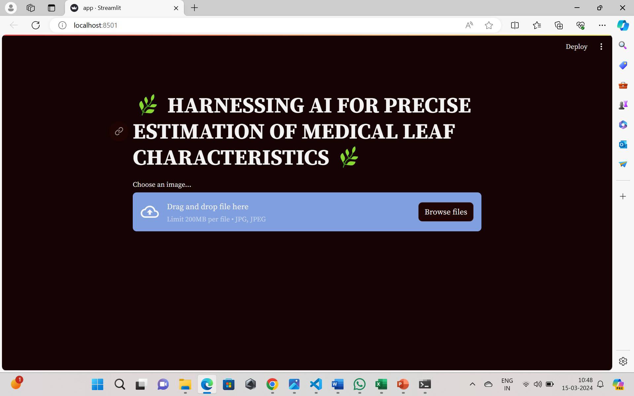
5.Interface Design:
Design an intuitive user interface that facilitates easy interaction with the system, catering to researchers, botanists, and enthusiasts. Ensure accessibility and usability through responsive design, intuitive navigation, and informative visualizations.
Front Page

Slide 23
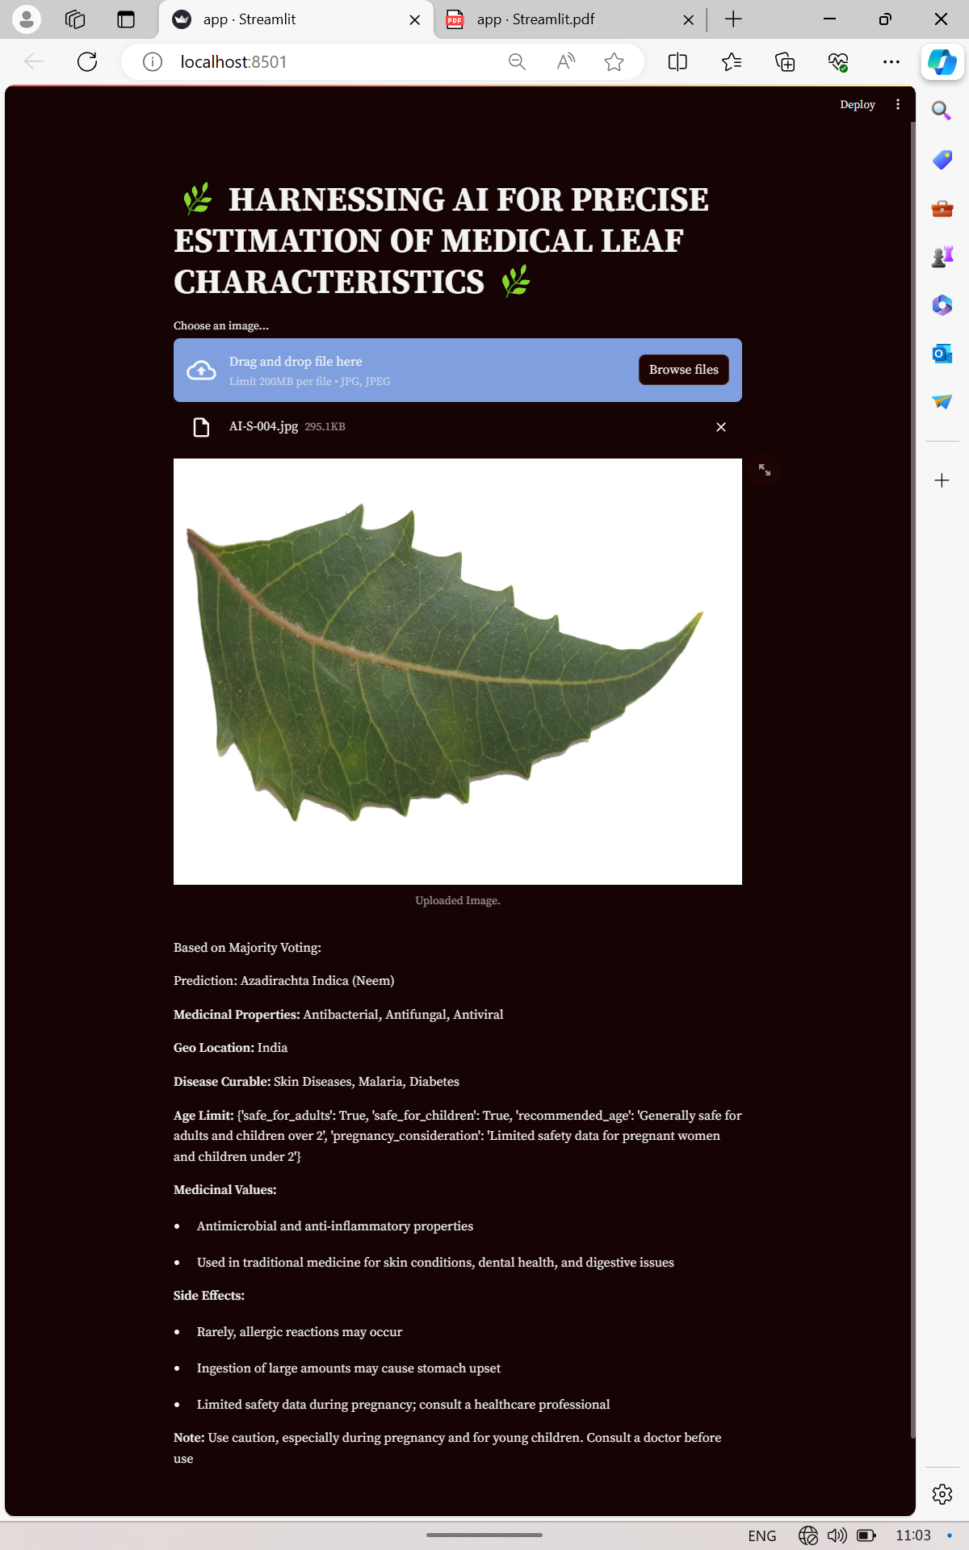
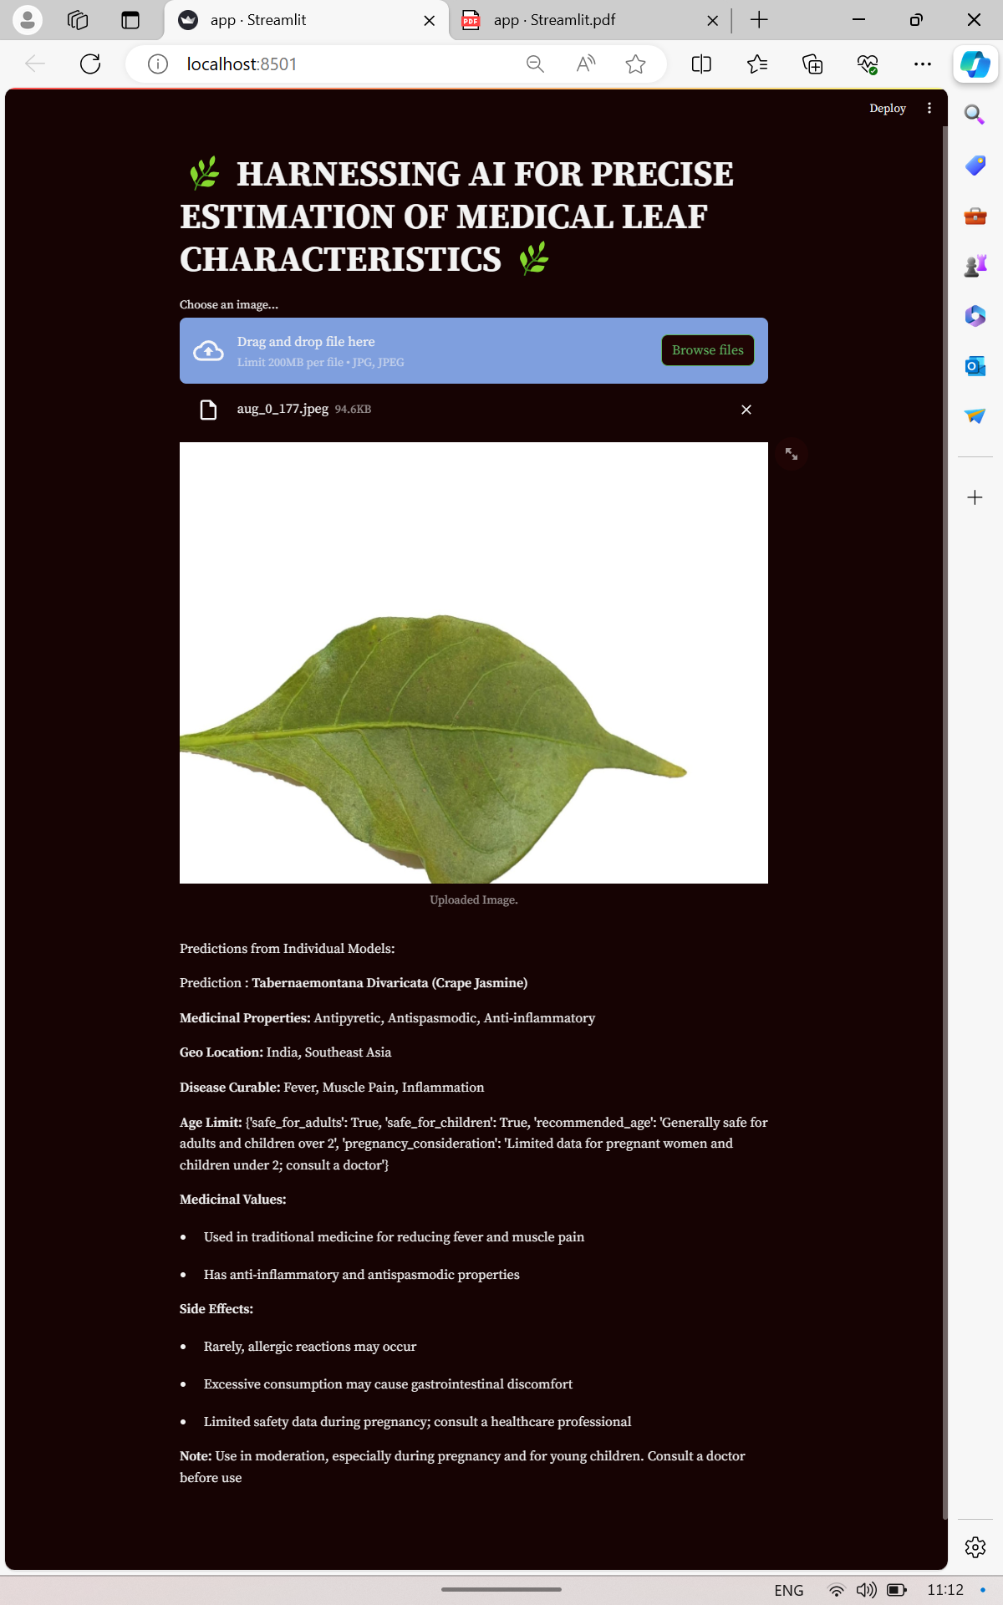
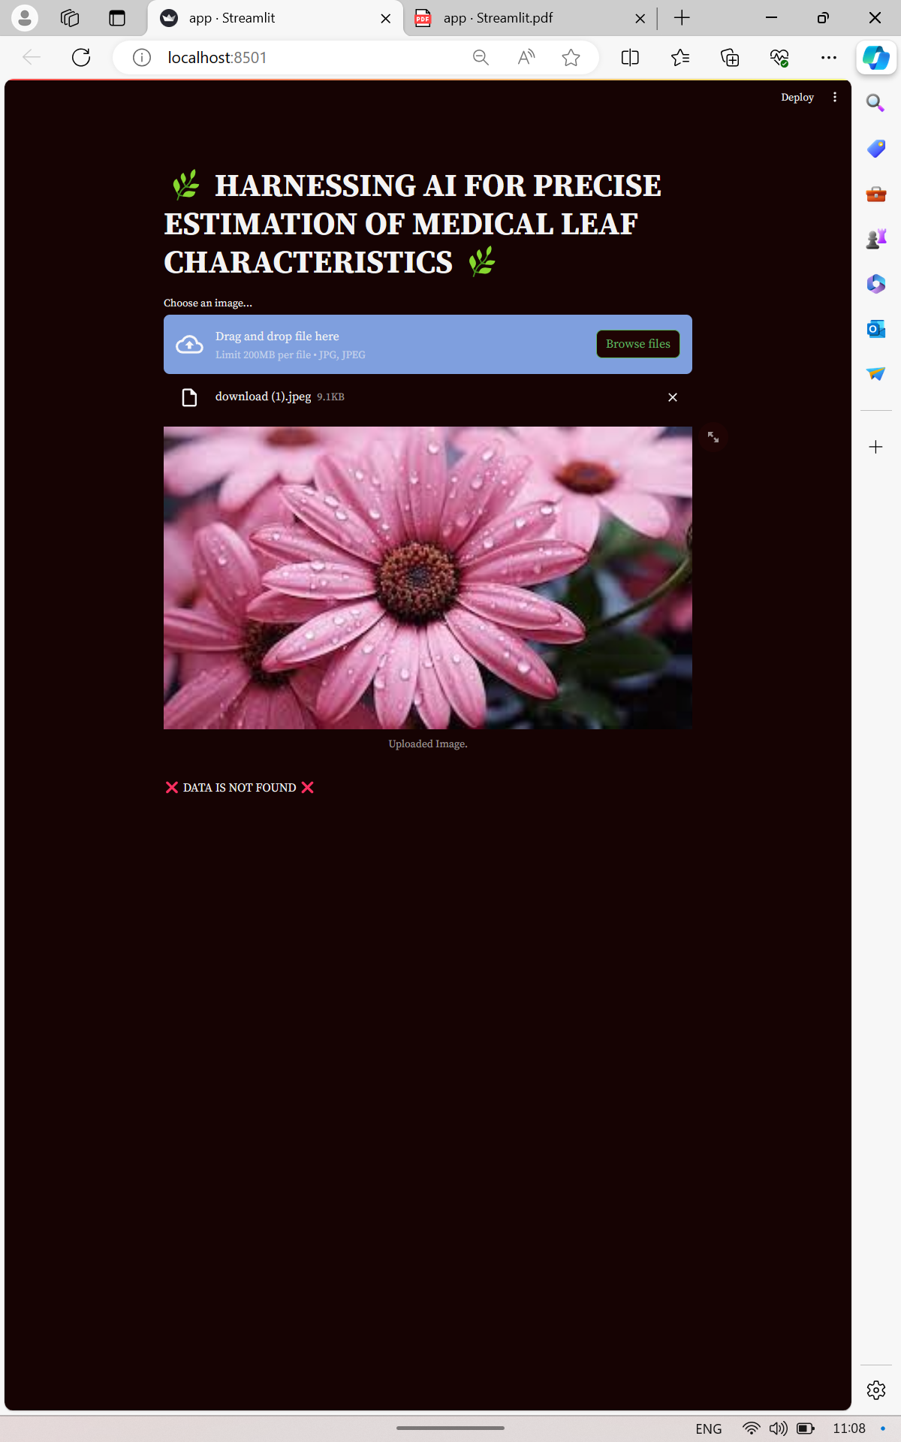
Individual output prediction
Majority voting output
Uploaded image not recognised

Slide 24
CONCLUSION
In conclusion, the "HARNESSING AI FOR PRECISE ESTIMATION OF MEDICAL LEAF CHARACTERISTICS" project marks a significant advancement in the field of plant science and Health care . By seamlessly integrating machine learning and deep learning algorithms, the system offers a precise and efficient means of identifying, characterizing, and analyzing medical leaves. The project not only contributes to the understanding of plant health but also provides valuable tools for researchers, practitioners. The accuracy, efficiency, and customization features ensure that the system is well-suited for diverse applications in botanical studies, ultimately promoting sustainable Healthcare practices. As technology continues to play a pivotal role in reshaping the landscape of agriculture, this project stands at the forefront, contributing to the ongoing efforts in harnessing AI for the betterment of plant health .

Slide 25
FUTURE WORK
Multi-Species Identification: Extend the system to support identification and characterization of a broader range of plant species beyond medicinal leaves, facilitating comprehensive botanical research.
Real-Time Data Integration: Implement mechanisms for real-time data acquisition and integration, enabling continuous updates on plant distributions, diseases, and environmental conditions.
Mobile Application Development: Develop a mobile application version of the system to enable field researchers and enthusiasts to access and utilize the tool on the go, fostering broader engagement and data collection.
Collaborative Research Initiatives: Foster collaborations with botanical researchers, healthcare professionals, and environmentalists to leverage domain expertise and enhance the system's effectiveness in addressing real-world challenges.
Longitudinal Studies: Conduct longitudinal studies to track changes in plant populations, disease prevalence, and environmental factors over time, providing valuable insights for ecological conservation and healthcare planning

Slide 26
References
[1] Naeem, S.; Ali, A.; Chesneau, C.; Tahir, M.H.; Jamal, F.; Sherwani, R.A.K.; Ul Hassan, M. The classification of medicinal plant leaves based on multispectral and texture feature using machine learning approach. Agronomy 2021.
[2] Automatic Recognition of Medicinal Plants using Machine Learning Techniques, InternationalJournal of Advanced Computer Science and Applications 2021
[3] Mukherjee, G.; Tudu, B.; Chatterjee, A. A convolutional neural networkdriven computer vision system toward identification of species and maturity stage of medicinal leaves: Case studies with Neem, Tulsi and Kalmegh leaves. Soft Computer. 2021.
[4] Bisen, D. Deep convolutional neural network based plant species recognition through features of leaf. Multimed. Tools Appl. 2021.
[5] Azadnia, R.; Kheiralipour, K. Recognition of leaves of different medicinal plant species using a robust image processing algorithm and artificial neural networks classifier. J. Appl. Res. Med. Aromat. Plants 2021.
[6] Russel, N.S.; Selvaraj, A. Leaf species and disease classification using multiscale parallel deep CNN architecture. Neural Comput. Appl. 2022.
[7] Paulson, A.; Ravishankar, S. AI Based Indigenous Medicinal Plant Identification. In Proceedings of the 2020 Advanced Computing and Communication Technologies for High Performance Applications (ACCT HPA), Cochin, India, 2–4 July 2020.
[8] Muneer, A.; Fati, S.M. Efficient and automated herbs classification approach based on shape and texture features using deep learning. IEEE Access 2020.

Slide 27
THANK YOU

